Slide 1
AQI Database
Air Quality Index Database
By: Eric Li, Harjot Grewal

Slide 2
System Description
Create a web app that allows users to see and interact with the AQI information of various countries
User can add, delete, or modify information in the database
User add new data by inputting the date, country’s name, air quality status, and AQI score
Can also add multiple new info at once via an excel sheet

Slide 3
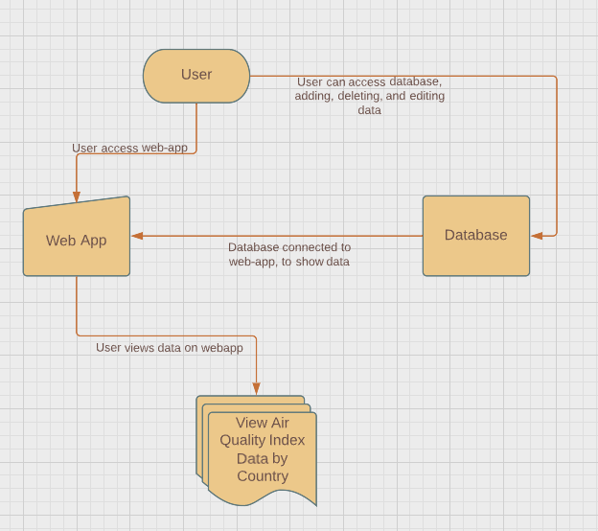
Use Case Diagram
Notes:
General Public, Weather Scientists, Media Outlets, Climate Scientists

Slide 4
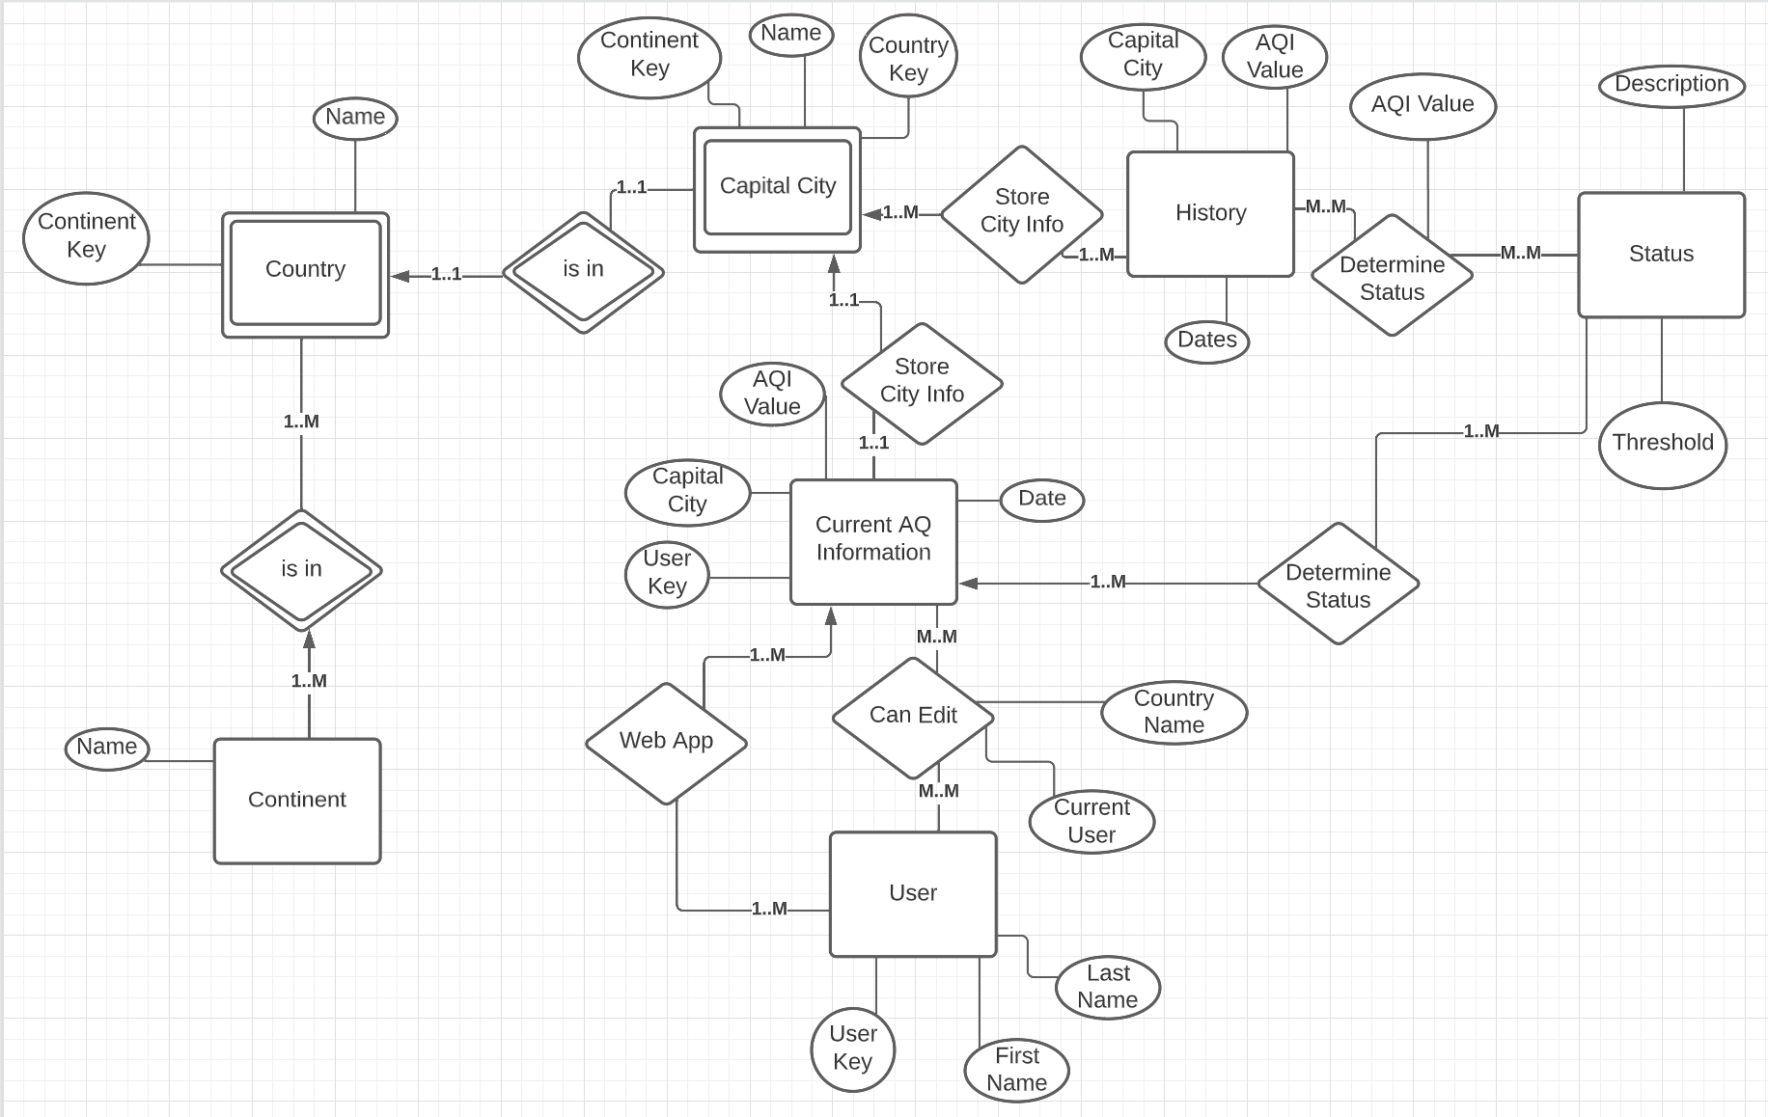
E/R Diagram

Slide 5
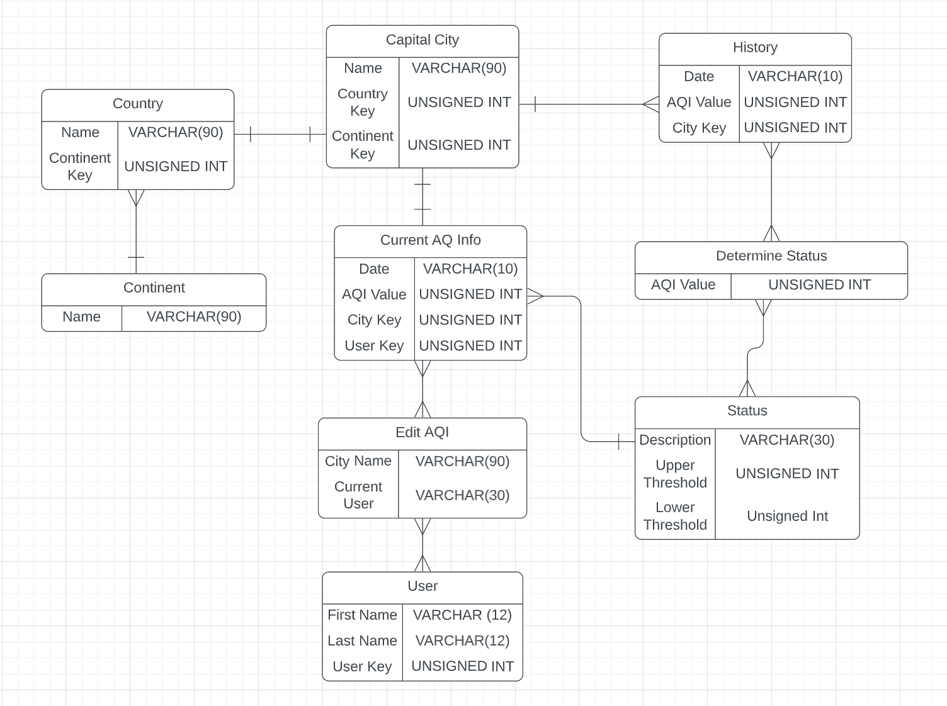
Relational
Schema
Notes:
Country Status Database User are entities
Missing 2 entities
1 mm
EDIT AQI keep as MM

Slide 6
Implementation Details
Front-end
Bootstrap
HTML5
Javascript
Back-end
SQLite
Node.js
Python

Slide 7
Demo Time!
Demo Time for 20 SQL Statements which display diversity

Slide 8
Thank You!
Any Questions?
Github Link: https://github.com/Jothu16/CSE111Project

